Slide 1
Are birds real?
Bryant

Slide 2
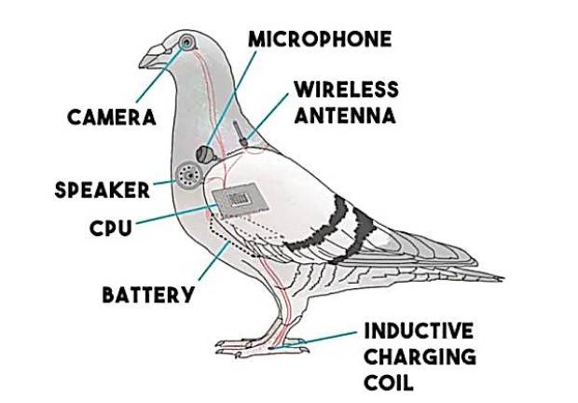
Do they sleep?
Birds don’t sleep; they charge.

Slide 3
Thank you.

